Slide 1

Predicting Life Insurance Risk Results
Presented By:
Brianna Abdalla
Data Science Capstone Project
June 5, 2023
Notes:
(This presentation was designed for a mixed audience) Welcome to my presentation for the independent Capstone 2 project with Springboards Data science program.

Slide 2

The Problem
It can take 3-6 weeks to gain approval on a new policy.
As of 2023, only 52% of U.S. households own life insurance.
What opportunities exist for Prudential Life insurance to shorten the application process and assess the risk of new life insurance applicants?
Notes:
If you own life insurance, you probably remember the joys of the application process. Find a reputable company, answer a million questions, complete a blood draw and wait for a month to hear what you qualify for and hope that it does not come at an expensive monthly premium. Prudential recognizes the dilemma for their customers: on average a life insurance application can take 3-6 weeks for approval. Due to this, many consumers avoid the process entirely leaving only 52% of U.S. households with life insurance. Prudential sought to improve the application process and launched a Kaggle competition that addresses this question: What opportunities exists for Prudential Life insurance to shorten the application process and assess the risk of new live insurance applicants.

Slide 3



Target Audience: Who Benefits?
Notes:
How does solving this problem benefit anyone: 1st it will directly benefit Prudential cutting associated costs and time dedicated to application evaluations. It will aid consumers by providing faster responses on their individual life insurance applications, allowing them to make faster and more informed decisions. And lastly, solving this problem could aid other companies who need to evaluate risk in their business dealings.

Slide 4

Data Challenges
The classes are very imbalanced.
Feature headings are ambiguous.
There are many outliers throughout.
10 features have greater than 15% missing data.
There are over 120 variables in the dataset.
Notes:
With clear problem and benefactor definitions, I went on to analyze the Prudential Dataset. The risk levels are stored in a column called Response. They are labeled 1-8 and are ordinal in nature. Meaning risk one is similar to risk 2, risk 5 is similar to risk 6 and so on. The first issue I noticed was the classes are imbalanced with over 30% of the data associated with response 8. Other challenges include the data being normalized, making it difficult to use intuitive judgment and the column names were not very helpful. There are many outliers in the data, columns that have significant missing data but are still correlated with risk, and over 120 columns to feed the model. Its important to identify this issues and come up with a plan for them because we want to accurately classify each risk level and avoid accidently inconvenience prudential customers by rejecting or accepting their application.

Slide 5
The Risk Distribution
Notes:
Here is bar graph that shows the number of life insurance applications for each class. It can be seen that class 8 holds the majority of the data and classes 3 and 4 have very little data. If class 8 has similar observations to other classes, its likely that the learning model will miss classify them to class 8. In real life, this could mean rejecting a customer who’s application should have been accepted.

Slide 6
Data Relationships
Where are the relationships among the variables?
Are there any significant relationships with the target variable?
= ?
x1
x +
Notes:
My next step in the process was find any preliminary relationships in the dataset. In other words, are there columns who's values relate to each other? A good example in this dataset is the relationship between Weight and BMI as wright go's up, BMI tends to follow. It is also important in this step to begin searching for variables that relate to the risk outcome.

Slide 7
Correlation: Target Variable
Positive Correlations
Product_Info_4:
Negative Correlations
BMI: -0.382
Wt: -0.351
Medical_Keyword_3: -0.258
Medical_Keyword_15: -0.259
Ins_Age: -0.210
Medical_History_23: 0.287
Medical_History_15: 0.277
Medical_History_4 : 0.240
Medical_History_39: 0.220
0.202
Notes:
Here are the strongest correlations associated with the applicant risk level. Using BMI as an example: there is an inverse association with BMI and Risk. On average, as BMI tends to increase the risk number decreases. This does not imply causation and we do not know for certain if risk class 1 is the highest risk or the lowest. All this is really telling us is that these variables seem to be loosely related to the risk values.

Slide 8
Feature Importance: Preliminary
Notes:
Because the correlations were lack luster, I moved on to build a preliminary model to rank feature importance based on the model. Here are the top ten important features that are used to classify risk level for the prudential dataset. I used this preliminary feature importance to reduce columns that I fed into final models for better accuracy and processing speeds.

Slide 9



Models Attempted
 | RandomForestClassifier |  |  |  | XGBoost |  |  |  | LightGBM
 | precision | recall | f1-score | support | precision | recall | f1-score | support | precision | recall | f1-score | support
Class 1 | 0.47 | 0.16 | 0.24 | 1241 | 0.45 | 0.24 | 0.31 | 1241 | 0.48 | 0.25 | 0.33 | 1241
Class 2 | 0.48 | 0.24 | 0.32 | 1310 | 0.42 | 0.24 | 0.31 | 1310 | 0.45 | 0.25 | 0.32 | 1310
Class 3 | 0.68 | 0.28 | 0.4 | 203 | 0.56 | 0.46 | 0.5 | 203 | 0.54 | 0.43 | 0.48 | 203
Class 4 | 0.6 | 0.67 | 0.63 | 286 | 0.62 | 0.67 | 0.64 | 286 | 0.6 | 0.67 | 0.64 | 286
Class 5 | 0.59 | 0.55 | 0.57 | 1086 | 0.59 | 0.53 | 0.56 | 1086 | 0.61 | 0.53 | 0.57 | 1086
Class 6 | 0.48 | 0.56 | 0.52 | 2247 | 0.51 | 0.52 | 0.52 | 2247 | 0.51 | 0.54 | 0.52 | 2247
Class 7 | 0.46 | 0.39 | 0.42 | 1606 | 0.47 | 0.43 | 0.44 | 1606 | 0.48 | 0.45 | 0.46 | 1606
Class 8 | 0.66 | 0.91 | 0.76 | 3898 | 0.67 | 0.9 | 0.77 | 3898 | 0.67 | 0.9 | 0.77 | 3898
accuracy |  |  | 0.57 | 11877 |  |  | 0.58 | 11877 |  |  | 0.58 | 11877
macro avg | 0.55 | 0.47 | 0.48 | 11877 | 0.54 | 0.5 | 0.51 | 11877 | 0.54 | 0.5 | 0.51 | 11877
weighted avg | 0.55 | 0.57 | 0.54 | 11877 | 0.55 | 0.58 | 0.55 | 11877 | 0.56 | 0.58 | 0.56 | 11877
AUC score: | 0.853 |  |  |  | 0.862 |  |  |  | 0.867
Notes:
We really want a model that classifies all 8 risk factors with decent accuracy, so it was important to try a few options. Random Forrest, Xgboost and LightGBM were the three I chose because they can handle missing values and outliers well. Out of the three LightGBM preformed the best on the AUC test metric.

Slide 10
Refine LightGBM
Added SMOTE sampling to over sample minority classes.
Reduced the train samples for class 8 to 9000.
 | LightGBM |  |  |  | LightGBM with SMOTE
 | precision | recall | f1-score | support | precision | recall | f1-score | support
Class 1 | 0.48 | 0.25 | 0.33 | 1241 | 0.64 | 0.55 | 0.59 | 3190
Class 2 | 0.45 | 0.25 | 0.32 | 1310 | 0.59 | 0.47 | 0.53 | 3110
Class 3 | 0.54 | 0.43 | 0.48 | 203 | 0.9 | 0.91 | 0.91 | 3175
Class 4 | 0.6 | 0.67 | 0.64 | 286 | 0.88 | 0.95 | 0.91 | 3159
Class 5 | 0.61 | 0.53 | 0.57 | 1086 | 0.7 | 0.68 | 0.69 | 3116
Class 6 | 0.51 | 0.54 | 0.52 | 2247 | 0.56 | 0.51 | 0.53 | 3034
Class 7 | 0.48 | 0.45 | 0.46 | 1606 | 0.57 | 0.67 | 0.62 | 3112
Class 8 | 0.67 | 0.9 | 0.77 | 3898 | 0.59 | 0.81 | 0.68 | 1732
accuracy |  |  | 0.58 | 11877 |  |  | 0.69 | 23628
macro avg | 0.54 | 0.5 | 0.51 | 11877 | 0.68 | 0.69 | 0.68 | 23628
weighted avg | 0.56 | 0.58 | 0.56 | 11877 | 0.69 | 0.69 | 0.68 | 23628
AUC score: | 0.867 |  |  |  | 0.935
Notes:
I further refined the LightGBM model so that it was trained with more samples from the minority classes and reduced the sample size for class 8. This resulted in a big improvement with accuracy and an even better AUC sore, meaning that each of the risk levels are more accurately predicted into their correct class and their associated probability's for that classification are ranked very well.

Slide 11
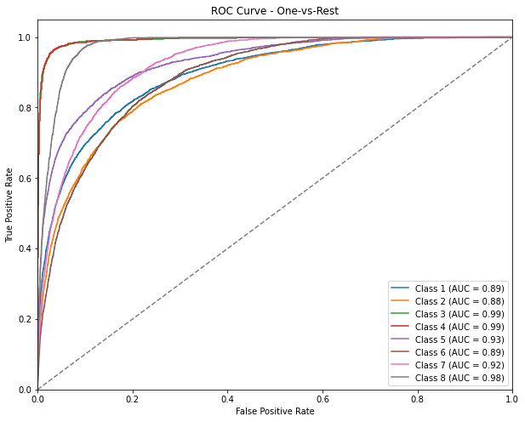
The Best Model: LightGBM SMOTE
Notes:
Here is the ROC AUC curve showing the performance of the model for each class and their individual AUC scores. The curve helps us assess how well the model distinguishes true positive classifications for each class (or 'risk value') from the remaining classes. Let's take the AUC score of class 8 as an example for better understanding.
The AUC score ranges between 0 and 1, with a higher value indicating a better ability to correctly rank true positives for that specific class against the other risk values. In this case, the AUC score for class 8 is 0.98, which suggests that the model has a high probability of accurately distinguishing true positives for risk level 8 compared to other risk values.
Higher AUC scores indicate better discriminatory power. This means that this model will assign probabilities and accurately rank them for a life insurance application which will in turn speed up the application process.

Slide 12
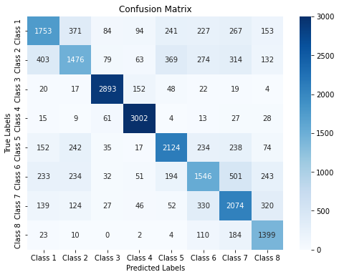
Confusion Matrix
Notes:
Here is a print out of the confusion matrix. It does kind of what it sounds like… it shows where the model gets confused and miss classifies. We can see that risk values 3 and 4 classify surprisingly well considering they have the least amount of information in the original dataset. Risk values 1 and 2 struggle between each other and misclassify as other classes. This is bit concerning because the classes are ordinal. So a one misclassifying as 8 is not ideal because they have very different risk meaning. Overall, given the complexity of the business problem, this model is classifying reasonably well. So what does Prudential gain from this?

Slide 13
Feature Importance: Final Model
Notes:
Well first of all, the model provides a top feature importance list. Prudential can use this for a better understanding of what attributes in their questionnaire affect the risk value. Interestingly, Medical History 15 was an attribute that had over 90% of its data missing, yet it is ranked highly in feature importance. So an answer or lack of an answer to that question in the application greatly effects the risk level outcome.

Slide 14
Recommendation for Prudential
The LightGBM model ranks class probabilities and delivers a decent accuracy.
Classes 3 & 4 classify exceptionally well.
Select the most important risk factors and fine tune.
Notes:
But how can the model be useful to prudential? We know that the LightGBM model ranks class probabilities very well and very accurately classifies risk levels 3 and 4. But what about the other classes? My recommendation for Prudential would be to select the most important risk value to classify and adjust the model to predict that risk value with greater accuracy. This could mean choosing the value that represents the least risk for an application and tuning the model to really classify on that specific value well. This in turn would allow faster processing for many of their applications and possibly improve customer acquisition if they are able to approve applications sooner.

Slide 15
Future Improvements
Try class weighing: place more weight on classes 1 ,2.
Adjust SMOTE Resampling and under sampling.
Create separate models for struggling classifications.
+
-
Notes:
Overall I really enjoyed working on this project. I learned the hard way in many different sections and overthought way to often. If I were to continue work on the project, I would try tuning the model to improve accuracy for classes 1 and 2. That might mean adjusting SMOTE resampling and under sampling. I would be curious to see the results of a model built to specifically classify on one risk value. This could be very useful for Prudential if there were a specific risk value of more importance.

Slide 16

Thank you!
Special thanks to my mentor:
Ajith Patnaik
Senior Manager – Risk Analytics
Notes:
Thank you!

